Slide 1


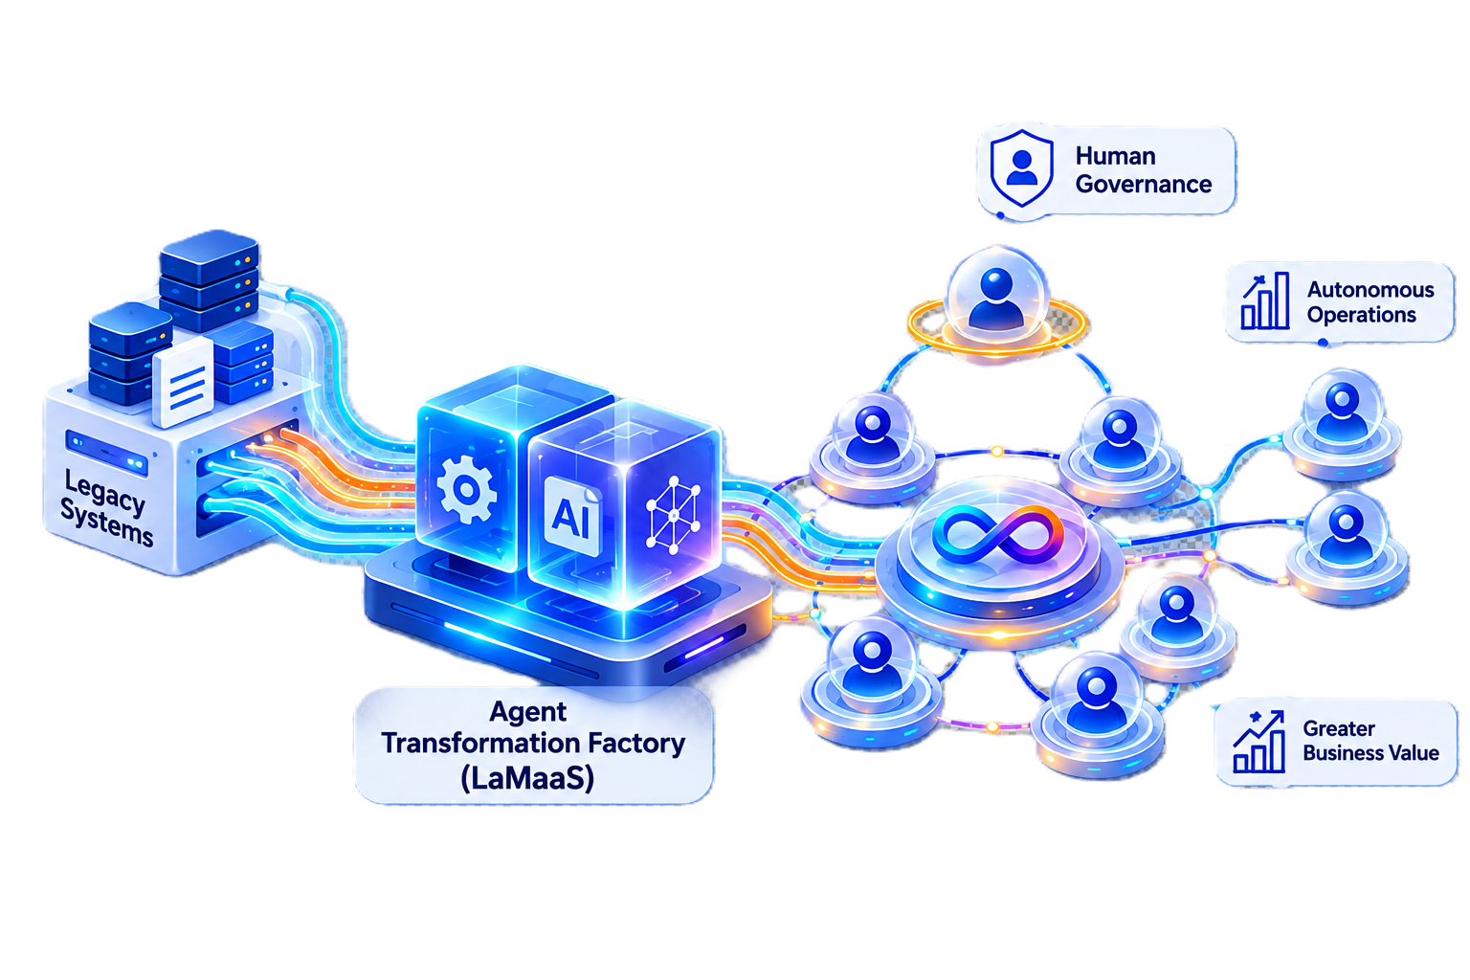
ZUCI — NEXT-GENERATION SERVICE OFFERINGS
Legacy-to-Agent Transformation
Factory
A repeatable methodology for upgrading 'Human-Run' centric Enterprise Workflows into 'Agent-Orchestrated, Human-Governed' workflows.
REDESIGN . GOVERN. DEPLOY. SCALE AI Agents Across Enterprise.
www.zucisystems.com · Dallas, TX (HQ) · India · Canada · Belgium . UK . Switzerland
© 2026 ZUCI SYSTEMS
1

Slide 2


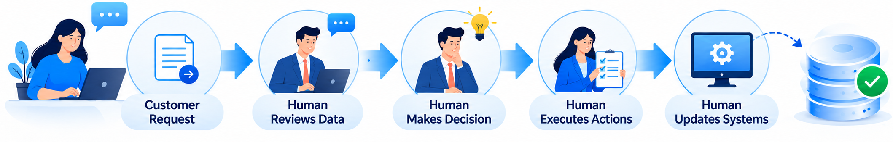
The Business Problem
Organizations Still Depend on 'Human-Run' centric workflows
Current State
Gather application and KYC documents.
Check KYC, income, credit, and financial details.
Approve, reject, or modify the loan based on policy.
Complete agreements, checks, and disbursement.
Update loan, banking, CRM, and audit systems.
Challenges
High Operational Cost
Knowledge Bottlenecks
Slow
Decision
Inconsistent
Decision
Limited
Scalability
The question isn't “where can we use AI” — it's “which processes are ready to be transformed.”
www.zucisystems.com · Dallas, TX (HQ) · India · Canada · Belgium . UK . Switzerland
© 2026 ZUCI SYSTEMS
2

Slide 3
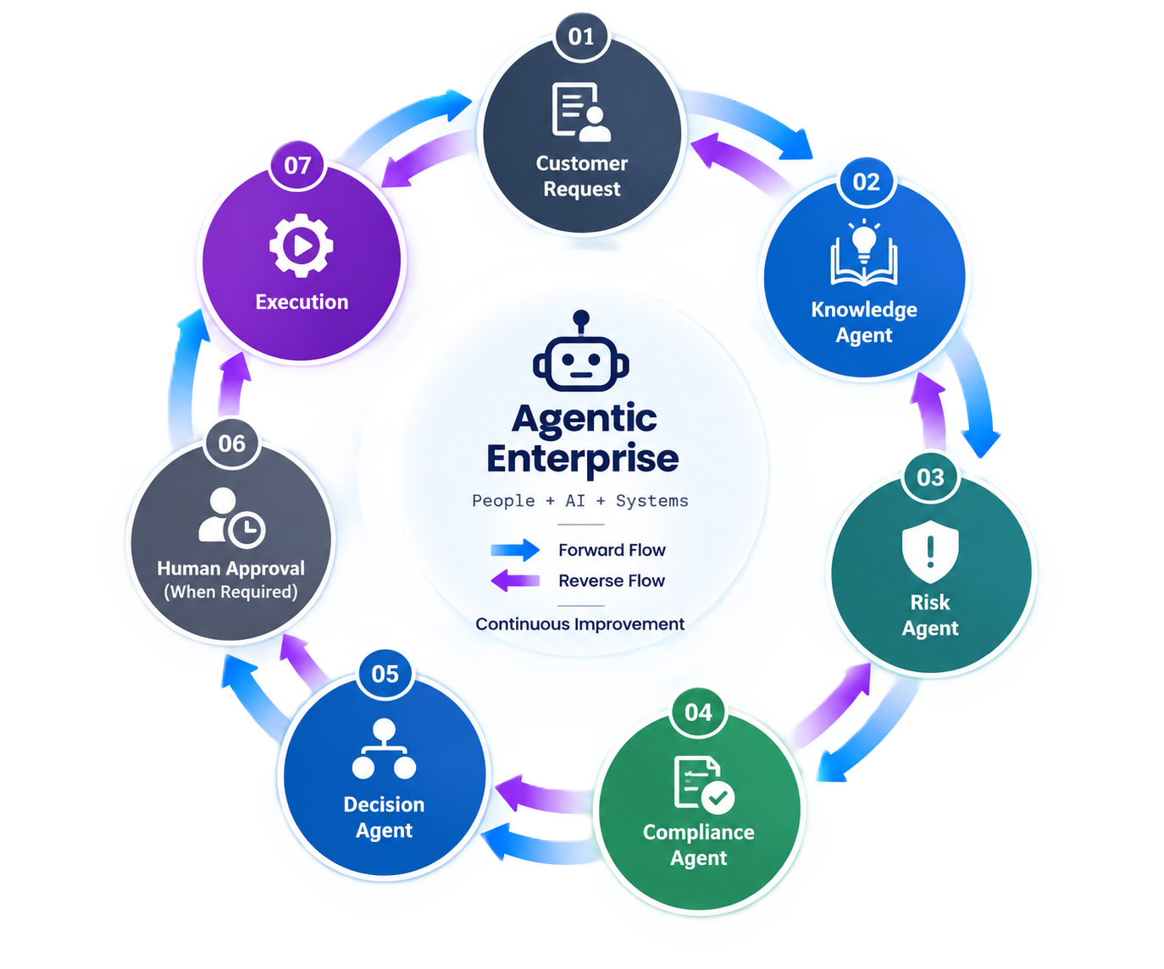
The Vision: The Agentic Enterprise
Humans manage exceptions. Agents perform routine work.
Inconsistent
Decision
Limited
Scalability
www.zucisystems.com · Dallas, TX (HQ) · India · Canada · Belgium . UK . Switzerland
© 2026 ZUCI SYSTEMS
3

Slide 4
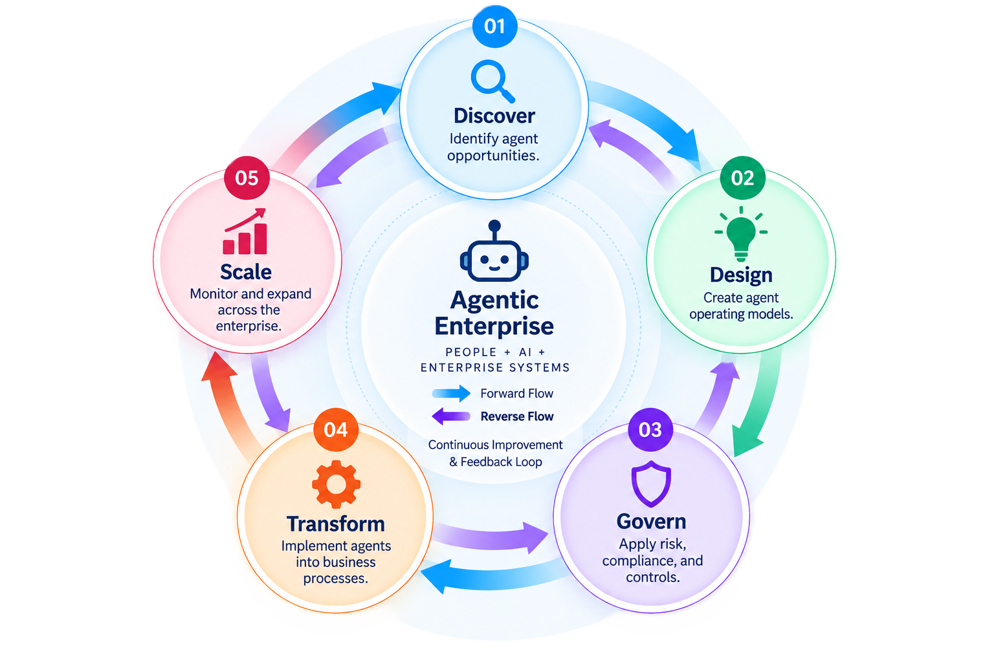
DISCOVER → DESIGN & IMPLEMENT → GOVERN → OPERATE
What is the Legacy-to-Agent Transformation Factory?
www.zucisystems.com · Dallas, TX (HQ) · India · Canada · Belgium . UK . Switzerland
© 2026 ZUCI SYSTEMS
4

Slide 5
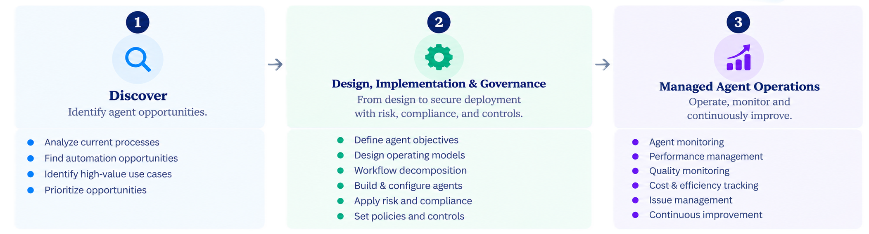
DISCOVER → DESIGN & IMPLEMENT → GOVERN → OPERATE
Agentic Transformation Lifecycle
Service Offering - Legacy-to-Agent Modernization as a Service (LAMaaS)
Transform legacy applications through an agent-powered modernization factory.
www.zucisystems.com · Dallas, TX (HQ) · India · Canada · Belgium . UK . Switzerland
© 2026 ZUCI SYSTEMS
5

Slide 6
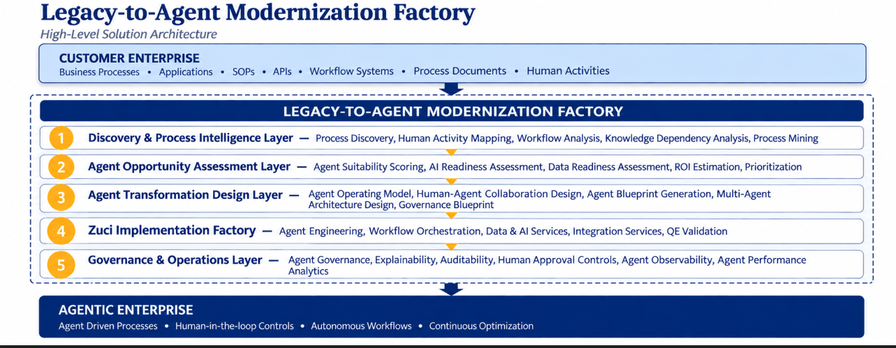
www.zucisystems.com · Dallas, TX (HQ) · India · Canada · Belgium . UK . Switzerland
© 2026 ZUCI SYSTEMS
6

Slide 7
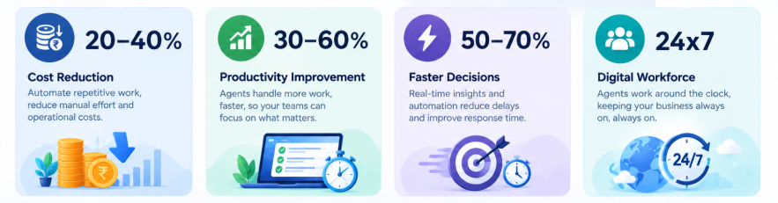
BUSINESS IMPACT
What Changes When Agents Run the Process
Agentic execution creates measurable value across the business
Better Compliance — reduced operational risk through built-in auditability. Improved Scalability — a 24x7 digital workforce that never queues.
Ranges reflect impact at maturity, phased across the 3-year Land → Prove → Scale roadmap.
www.zucisystems.com · Dallas, TX (HQ) · India · Canada · Belgium . UK . Switzerland
© 2026 ZUCI SYSTEMS
7

Slide 8
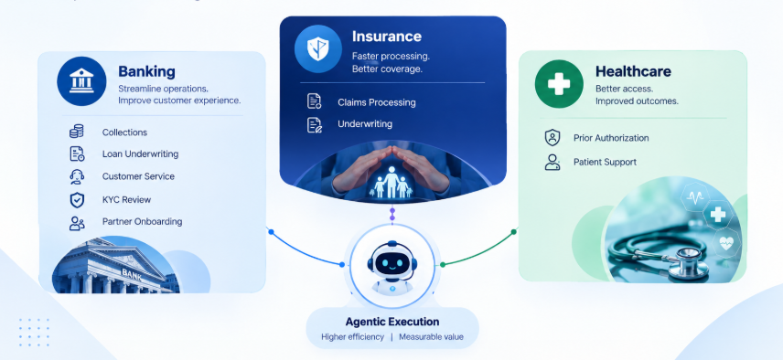
CUSTOMER VALUE
Representative Agent Opportunities
Business processes where agentic execution can create measurable value.
Insurance
www.zucisystems.com · Dallas, TX (HQ) · India · Canada · Belgium . UK . Switzerland
© 2026 ZUCI SYSTEMS
8

Slide 9
MARKET OPPORTUNITY · HORIZONTAL PLAY
Sizing the Legacy-to-Agent Opportunity
Any enterprise with high-volume, repeatable, human-run processes is addressable — not just BFSI.
Market potential - Upto 233 Bn$ in 2033 ( 40% CAGR)
TAM → SAM → SOM
WHERE ZUCI ALREADY FOCUSES
TAM $7.6B–$11.6B
$2.4B SAM by target industry — market availability & earn potential
Global AI Agents / Agentic AI market (2025)
SAM ≈$2.4B
Zuci-addressable: BFSI, Insurance, Healthcare + expansion verticals
SOM $15–20M
Zuci's realistic 3-year capture (existing target)
Sources: Grand View Research ($7.6B); MarketsandMarkets ($11.6B); Precedence Research ($7.9B) — 2025 estimates. SAM/SOM are Zuci estimates, not independently published data.
Illustrative allocation of the $2.4B SAM across Zuci’s current accounts and horizontal expansion verticals — Zuci estimate, not independently published data.
WHO IS THE BUYER
TARGET INDUSTRIES
MARKET TRENDS - Agentic AI
CIO · COO · Chief Digital Officer · Head of Operations · Business Unit Leaders
Primary: BFSI, Insurance, Healthcare
Expansion: Manufacturing, Retail, Telecom, IT/ITeS, Government
✓ Independent forecasts project 40–50% CAGR (2026–2033).
ZUCI 3-YEAR COMMERCIAL TARGET
www.zucisystems.com · Dallas, TX (HQ) · India · Canada · Belgium . UK . Switzerland
© 2026 ZUCI SYSTEMS
9

Slide 10
OFFERING DEFINITION · COMMERCIAL STRATEGY
Earning Model
1
→
2
→
3
→
4
→
5
Agent Discovery
Assessment
Agent Design /
Blueprinting
Agent
Implementation
Agent Governance
Services
Managed Agent
Operations
GOAL
CORTEX
IGNITEZ
TRUZT AI
ZOY
Score candidate processes for transformation readiness.
Knowledge, Risk, Compliance & Decision agents — blueprinted per process.
Orchestration platform for complex, interdependent workflows.
Automated Gen-AI quality assurance and output evaluation.
Enterprise control plane — observability, learning, impact tracking.
PRICING — ILLUSTRATIVE, SCOPE-BASED (NOT SEAT-BASED)
PILOT
PROGRAM
ENTERPRISE PARTNERSHIP
$25K–150K
$300K–750K
$1M–2M+/yr
One process, one business unit
3–5 processes, one function
Org-wide
Assessment + Blueprint + working pilot
Milestone-based, bundled accelerator discount
Retainer + optional outcome-based share
Illustrative price points — Zuci's proposed commercial figures, not external market research. Usage-based and outcome-based layers available on top of Program/Enterprise tiers.
www.zucisystems.com · Dallas, TX (HQ) · India · Canada · Belgium . UK . Switzerland
© 2026 ZUCI SYSTEMS
10

Slide 11
DIFFERENTIATION · AI-NATIVE
Innovation & Entry Barriers for Competition
WHAT'S ACTUALLY NOVEL HERE
Customer
Enterprise
→
1
2
3
4
5
Discovery
→
Assessment
→
Design
→
→
Governance
→
Agentic
Enterprise
Implementation
Capabilities
Proprietary Assets
IGNITEZ, ZOY, CORTEX, TRUZT AI — already running in production.
Digital Engineering, QE, Architecture Advisory, and BFSI/healthcare domain expertise already combined under one roof.
What's new is the methodology: a scored, repeatable way to package them into a sellable transformation service, with genuine multi-agent reasoning at the core, instead of one-off engagements.
www.zucisystems.com · Dallas, TX (HQ) · India · Canada · Belgium . UK . Switzerland
© 2026 ZUCI SYSTEMS
11

Slide 12
Competitive Landscape
12 IT-services rivals, grouped by what they lead with. Dots show overlap with Zuci’s proposal.
PLATFORM
They sell a tool
VISION
They sell a reinvention story
OPERATIONS
They sell process execution
ZUCI’S WEDGE
Accenture
●●●○
Deloitte
●●●○
Cognizant
●●●●
Focus
Mid-market BFSI + existing Zuci relationships, not a horizontal platform play
Packaging
A named, scored methodology (Assessment → Score → Blueprint → Pilot), not open-ended consulting
Proof
Shipped BFSI work (credit union automation, agentic document intelligence, 80% mortgage auto-approval) the big SCs pitch only conceptually
Enterprise AI Heavy
Digital Workforce
Process Agentification
Infosys
●●○○
TCS
●●●○
Wipro
●●○○
Topaz Ecosystem
Autonomous Enterprise
Autonomous Ops
IBM
●●○○
Capgemini
●●●○
Genpact
●○○○
Governed Enterprise AI
Pilot-to-Scale
Operations-Led
HCL Tech
●●○○
EY
●●○○
LTI Mindtree
●○○○
Reusable Agents
Advisory-Led
Engineering-Led
The GAP: none of the 12 leads its pitch with the first step — which process to agentify, what it returns, and in what order to scale.
www.zucisystems.com · Dallas, TX (HQ) · India · Canada · Belgium . UK . Switzerland
© 2026 ZUCI SYSTEMS
12

Slide 13
IMPLEMENTATION ROADMAP · STRATEGIC IMPACT
Future Projections
OPEN
MULTIPLY
COMPOUND
Months 0–6
Year 1
Years 2–3
Expand across BFSI + healthcare toward the $15–20M target, via existing Zuci relationships.
Build a high-performing pilot team of Architect, Leads, 4 Developers.
Build Working Solution Accelerators for the 3 Service Lines – Discovery, Design & Implementation, Managed Operations.
Engage existing clients to identify high-value processes, validate agentic solutions through targeted pilots, and establish measurable ROI.
.
→
→
GO-TO-MARKET
STRATEGIC IMPACT
Enter via Pilot tier with 1–2 existing Zuci BFSI/healthcare relationships
Prove ROI, convert to Program tier
Cross-sell into adjacent processes within the same account before expanding to new logos
Moves Zuci from AI Implementation Partner → Agentic Enterprise Transformation Partner
Complements Digital Engineering, Architecture Advisory, Data & AI, Modernization Services
Unlocks future lines: Governance-as-a-Service, Agent QA/Observability, Industry Agent Platforms
Start with the problem. Prove the value. Then scale the transformation.
www.zucisystems.com · Dallas, TX (HQ) · India · Canada · Belgium . UK . Switzerland
© 2026 ZUCI SYSTEMS
13

Slide 14
WHY ZUCI
The Client Brings the Problem.
We Bring the Transformation Capability.
EXISTING CAPABILITIES
Digital Engineering
AI & Data
QE
Architecture Advisory
BFSI Domain Expertise
WHAT PREVENTS COPYING — THE DIFFERENTIATION IS NOT THE LLM
Agent Transformation Methodology
Governance Framework
Reusable Accelerators
Proprietary assets: Agent Readiness Framework · Process-to-Agent Mapper · Agent Architecture Templates · Governance Accelerators · BFSI Agent Playbooks — becoming reusable IP.
www.zucisystems.com · Dallas, TX (HQ) · India · Canada · Belgium . UK . Switzerland
© 2026 ZUCI SYSTEMS
14

Slide 15
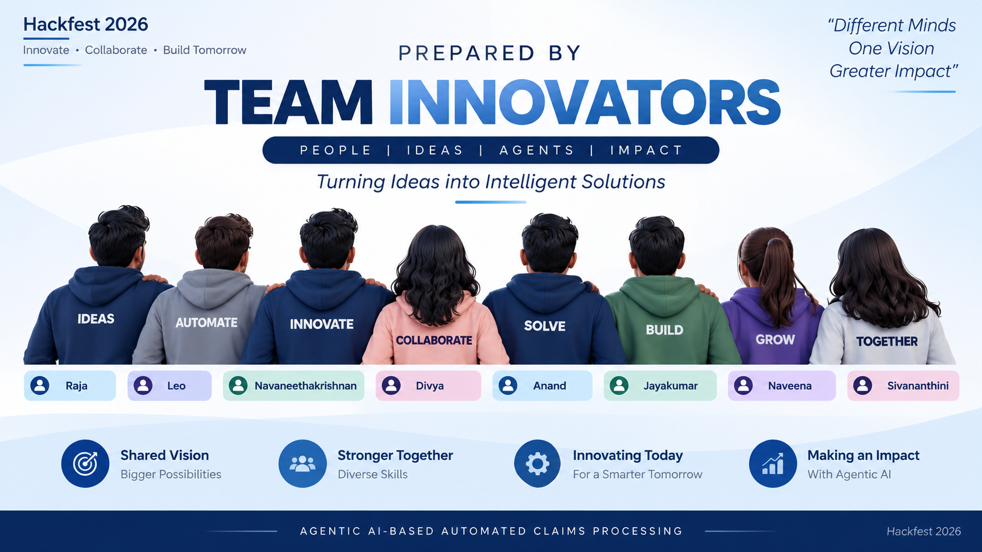
www.zucisystems.com · Dallas, TX (HQ) · India · Canada · Belgium . UK . Switzerland
© 2026 ZUCI SYSTEMS
15

Slide 16

Thank You
© 2026 ZUCI SYSTEMS

